Slide 1
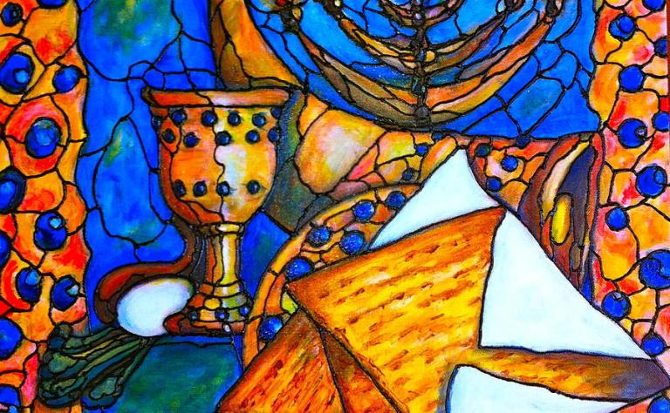
PESACH 2023
by Dr Hadassah

Slide 2
Haggadah
Retelling the Story of PESACH

Slide 4
“NO ONE SHOULD APPEAR EMPY HANDED”
Exodus 23:15, “Hold the spring Festival of Unraised Bread when you eat unraised bread for seven days at the time set for the month of Abib, as I commanded you. That was the month you came out of Egypt. No one should show up before me empty-handed.

Slide 5
Deuteronomy 16:1, 6, 16
1. Observe the month of Abib, and keep the Passover to the Lord your God, for bin the month of Abib the Lord your God brought you out of Egypt by night.
6. but at the place where the Lord your God chooses to make His name abide, there you shall sacrifice the Passover at twilight, at the going down of the sun, at the time you came out of Egypt.
16. “Three times a year all your males shall appear before the Lord your God in the place which He chooses: at the Feast of Unleavened Bread, at the Feast of Weeks, and at the Feast of Tabernacles; and they shall not appear before the Lord empty-handed.

Slide 6
Exodus 12:3-14
3. Speak to all the congregation of Israel, saying: ‘On the tenth of this month every man shall take for himself a lamb, according to the house of his father, a lamb for a household.
4. And if the household is too small for the lamb, let him and his neighbor next to his house take it according to the number of the persons; according to each man’s need you shall make your count for the lamb.
5. Your lamb shall be without blemish, a male of the first year. You may take it from the sheep or from the goats.

Slide 7
6. Now you shall keep it until the fourteenth day of the same month. Then the whole assembly of the congregation of Israel shall kill it at twilight.
7. And they shall take some of the blood and put it on the two doorposts and on the lintel of the houses where they eat it.
8. Then they shall eat the flesh on that night; roasted in fire, with unleavened bread and with bitter herbs they shall eat it.
9. Do not eat it raw, nor boiled at all with water, but roasted in fire—its head with its legs and its entrails.
10. You shall let none of it remain until morning, and what remains of it until morning you shall burn with fire.

Slide 8
11. And thus you shall eat it: with a belt on your waist, your sandals on your feet, and your staff in your hand. So you shall eat it in haste. It is the Lord’s Passover.
12. ‘For I will pass through the land of Egypt on that night, and will strike all the firstborn in the land of Egypt, both man and beast; and against all the gods of Egypt I will execute judgment: I am the Lord.
3. Now the blood shall be a sign for you on the houses where you are. And when I see the blood, I will pass over you; and the plague shall not be on you to destroy you when I strike the land of Egypt.
14. ‘So this day shall be to you a memorial; and you shall keep it as a feast to the Lord throughout your generations. You shall keep it as a feast by an everlasting ordinance.

Slide 10
1 Cor 11:23-26
23 For I received from the Lord that which I also delivered to you: that the Lord Jesus on the same night in which He was betrayed took bread;
24 and when He had given thanks, He broke it and said, "Take, eat; this is My body which is broken for you; do this in remembrance of Me."
25 In the same manner He also took the cup after supper, saying, "This cup is the new covenant in My blood. This do, as often as you drink it, in remembrance of Me."
26 For as often as you eat this bread and drink this cup, you proclaim the Lord's death till He comes.

Slide 11
Yeshua was crucified on erev Pesach, buried during Unleavened Bread, and was resurrected on First fruits. The feast of Pentecost was the day the Ruach HaKodesh (Holy Spirit) fell on believers in fulfilment of the promise given by our Lord

Slide 12
Exodus 6:6-7
6 Therefore say to the children of Israel: ‘I am the Lord; I will bring you out from under the burdens of the Egyptians, I will rescue you from their bondage, and I will redeem you with [a]an outstretched arm and with great judgments.
7 I will take you as My people, and I will be your God. Then you shall know that I am the Lord your God who brings you out from under the burdens of the Egyptians.

Slide 13
The Four Promises and The Four Cups
The Cup of Sanctification – I will bring you out from Egypt
The Cup of Deliverance – I will deliver you from bondage
The Cup of Redemption – I will redeem you with my power
The Cup of Restoration – I will take you as my people

Slide 14
1. The Cup of Sanctification
Messiah Yeshua is our sanctification.
1 Cor 1:30
30 But of Him you are in Messiah Yeshua, who became for us wisdom from God -- and righteousness and sanctification and redemption--

Slide 15
2. The Cup of Deliverance (10 plagues)
He has taken us out of this sinful world into His kingdom.
Col 1:13
13 He has delivered us from the power of darkness and conveyed us into the kingdom of the Son of His love

Slide 16
10 plagues
1. Blood | 6. Boils, blisters, ulcers, tumors for the injury of our people;
2. Frogs for the cries of our people | 7. Hail mixed with fire
3. Lices for the constant oppression | 8. Locusts
4. Flies attacks of the taskmasters | 9. Darkness for the worship of the sun god, Ra;
5. Pestilence for livestock | 10. The death of the first born

Slide 17
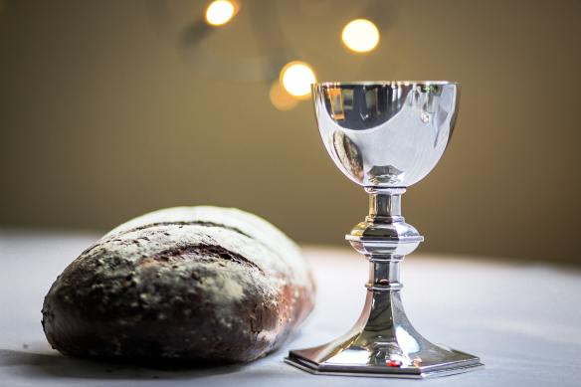
3. The Cup of Redemption
At the 3rd cup, the cup of redemption, he said: “This is my blood of the New Covenant” (Matt 26:27-39).

Slide 18
Matt 26:27-39
27 Then He took the cup, and gave thanks, and gave it to them, saying, “Drink from it, all of you. 28 For this is My blood of the new covenant, which is shed for many for the remission of sins.
29 But I say to you, I will not drink of this fruit of the vine from now on until that day when I drink it new with you in My Father’s kingdom.” 30 And when they had sung a hymn, they went out to the Mount of Olives. 31 Then Jesus said to them, “All of you will be made to stumble because of Me this night, for it is written:
‘I will strike the Shepherd, And the sheep of the flock will be scattered.’
32 But after I have been raised, I will go before you to Galilee.”

Slide 19
33 Peter answered and said to Him, “Even if all are made to stumble because of You, I will never be made to stumble.”
34 Jesus said to him, “Assuredly, I say to you that this night, before the rooster crows, you will deny Me three times.” 35 Peter said to Him, “Even if I have to die with You, I will not deny You!” And so said all the disciples.
36 Then Jesus came with them to a place called Gethsemane, and said to the disciples, “Sit here while I go and pray over there.” 37 And He took with Him Peter and the two sons of Zebedee, and He began to be sorrowful and deeply distressed. 38 Then He said to them, “My soul is exceedingly sorrowful, even to death. Stay here and watch with Me.”
39 He went a little farther and fell on His face, and prayed, saying, “O My Father, if it is possible, let this cup pass from Me; nevertheless, not as I will, but as You will.”

Slide 20
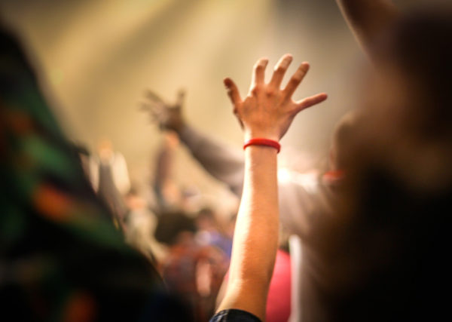
4. The Cup of Restoration/Praise
Yeshua told his disciples that he would not drink the fourth cup, (the cup of restoration), but promised to do so with them in the coming Kingdom (Matt 26:29)

Slide 21
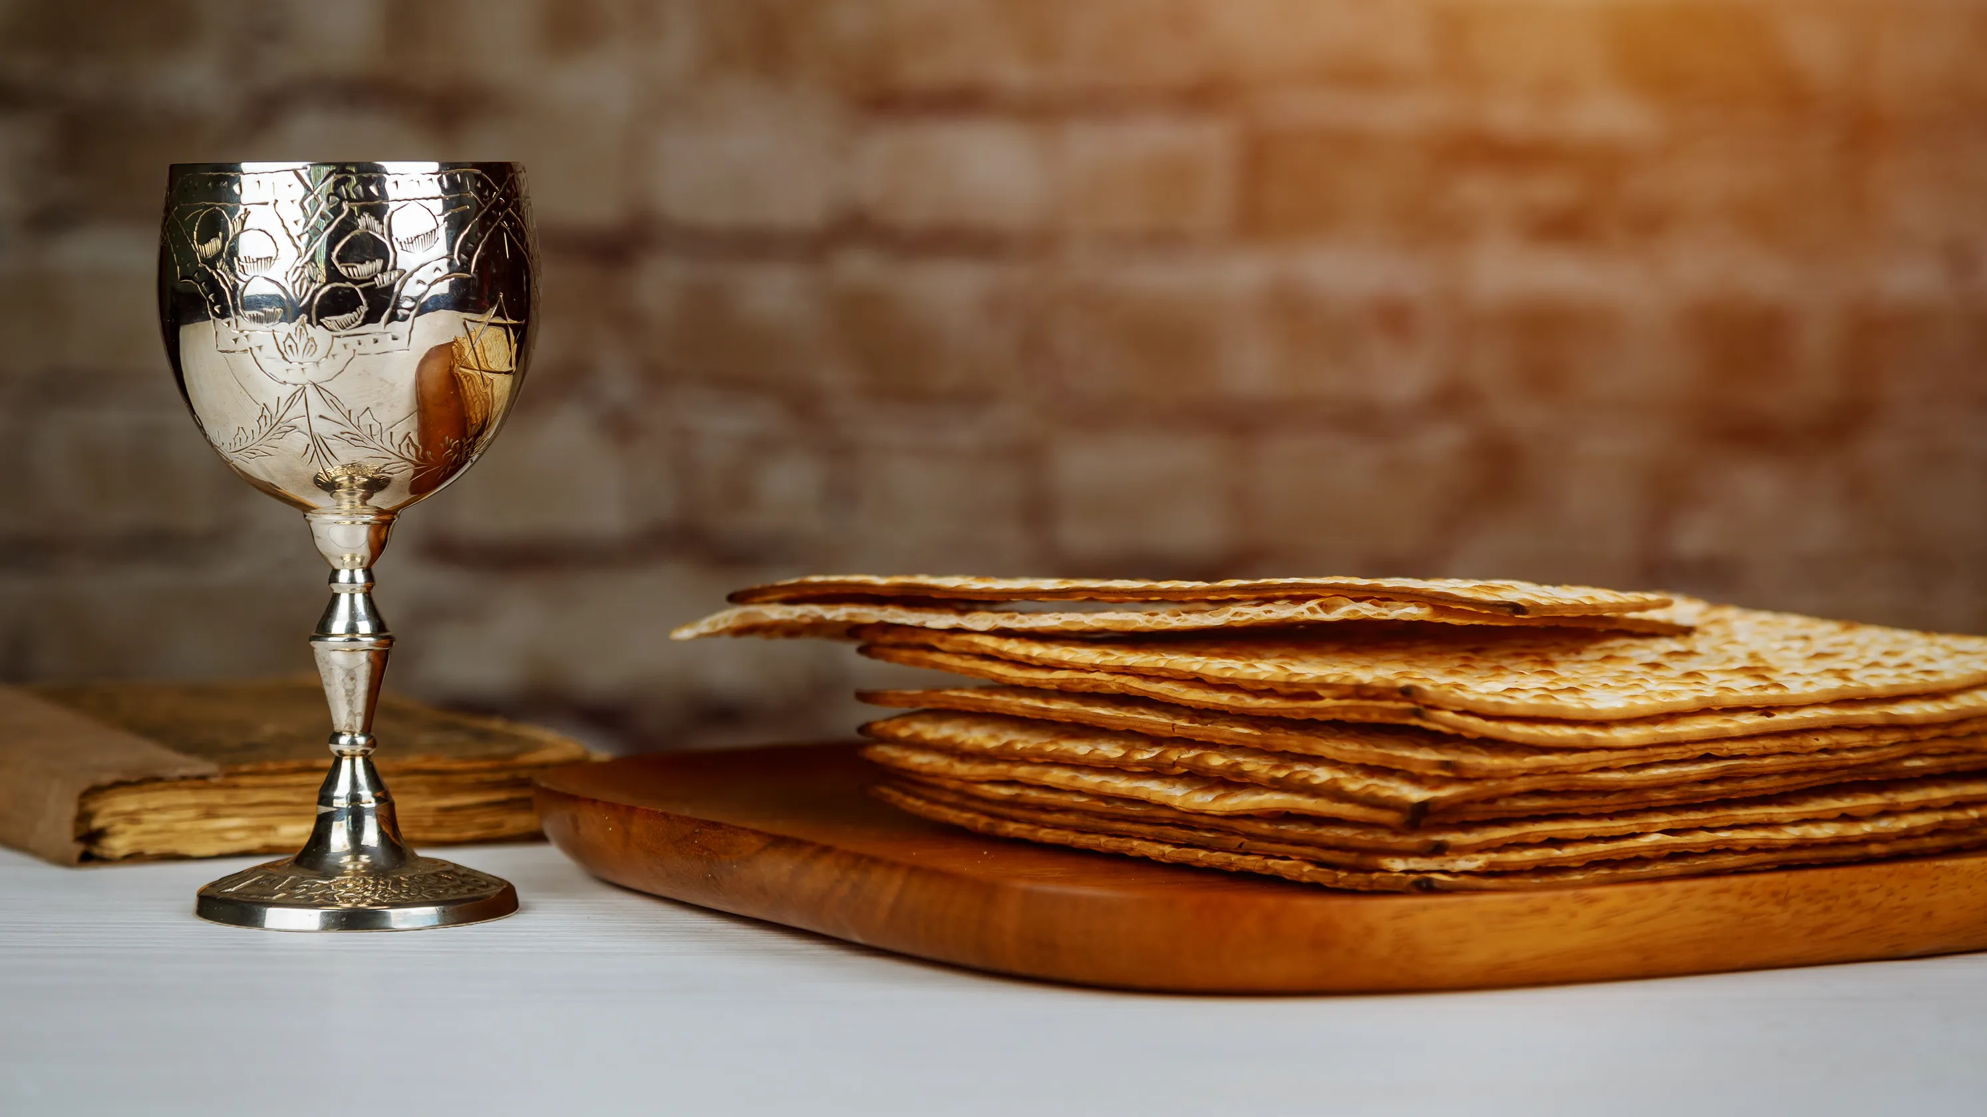
The 4 Main Elements (biblical)
Matza
Wine
Bitter herbs
Lamb

Slide 22
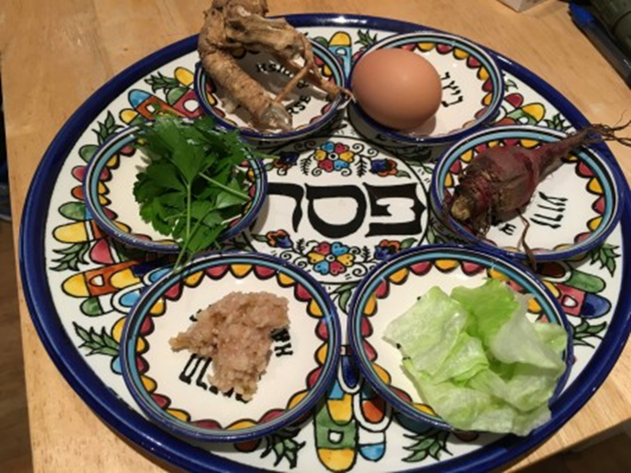
Passover Sedar
Karpus – parsley dipped into salt water – representing tears and the growth of vegetation and fertility of the Jewish people in Egypt.
Charoset – apples, nuts, cinnamon – represent the bricks that they used in Egypt
Maror – horseradish – represent the bitterness and harshness of slavery of the Israelites
Zero’a – roasted lamb shank bone – represent the lamb of Pesach

Slide 23
The 4 questions and The 4 answers
Why do we eat matzah instead of challah? Matzah has no leaven – remember the bread of affliction when we were slaves and how our people fled Egypt in such a hurry with no time for the bread dough to rise.
Why do we eat the bitter herbs? To remember the bitterness of slavery in Egypt.
Why do we dip our herbs twice? To remember the salty tears of the slaves and the red sea that they crossed. We also eat charoset with the maror to remember the bitterness of slavery and the sweet hope in Adonai for our freedom
Why do we recline at the table? We recline tonight as a symbol of our freedom.

Slide 24
Steps of Passover
Lighting the candles
1
Sanctify the wine (Kidush)
2
Drink the first cup of Sanctification
3

Slide 25
Steps of Passover
Dipping the Parsley
4
Breaking of the Matzah (Afikoman; Matt 26:26 Close your eyes and remember Yeshua. “This is my body that is given for you; do this in memory of me”.
5
Telling the Story (2nd cup, the plagues)
6

Slide 26
Steps of Passover
Eating Matzah
7
Eating Charoset (remember the bricks)
8
Eating Bitter Herbs (tears)
9

Slide 27
Steps of Passover
Eating Bitter Herbs with charoset (tears with bricks)
10
The Cup of Deliverance (half cup, using little pinky, dip into the cup to drop 10 drops onto napkin, representing the 10 plagues, each plague is named in the retelling, as we spill the wine. *
11
Cup of Redemption
12

Slide 28
12. Cup of Redemption – Yeshua - “I’ll redeem you with an outstretched arm – cup of blessing.
The wine in this cup recalls the shed blood of the lamb that was applied to the doorposts in Egypt, causing the plague of death to pass over. Similarly, Yeshua associated this cup with the blood he would shed on the cross causing death to “pass over” those trusting in him. This is the cup of the new covenant, that is, God’s agreement to regard all those who trust in the death of the Messiah for the forgiveness of their sins to be justified and made right with Him. Of Yeshua it is said, “The Messiah our Redemption” (1 Cor 1:30)
Let us again be silent for a moment… Close your eyes and hold this cup in your hands. This Cup of Redemption represents God’s new covenant, and the very blood of Yeshua that was shed for the forgiveness of your sins on the cross… Let us recite the traditional blessing and then drink of the cup full of assurance that we are accepted and beloved by our Lord.

Slide 29
Last but not least
The Cup of Restoration/Cup of praise
Yeshua told his disciples that he would not drink the fourth cup, (the cup of restoration), but promised to do so with them in the coming Kingdom (Matt 26:29)
Be Chol dor vador
In each and every generation an individual should look upon him or herself as if he or she personally had left Egypt

Slide 30
What is the cup of Elijah?
Malachi 4:5-6
5 Behold, I will send you Elijah the prophet before the coming of the great and dreadful day of the Lord.
6 And he will turn
The hearts of the fathers to the children,
And the hearts of the children to their fathers,
Lest I come and strike the earth with a curse.

Slide 35
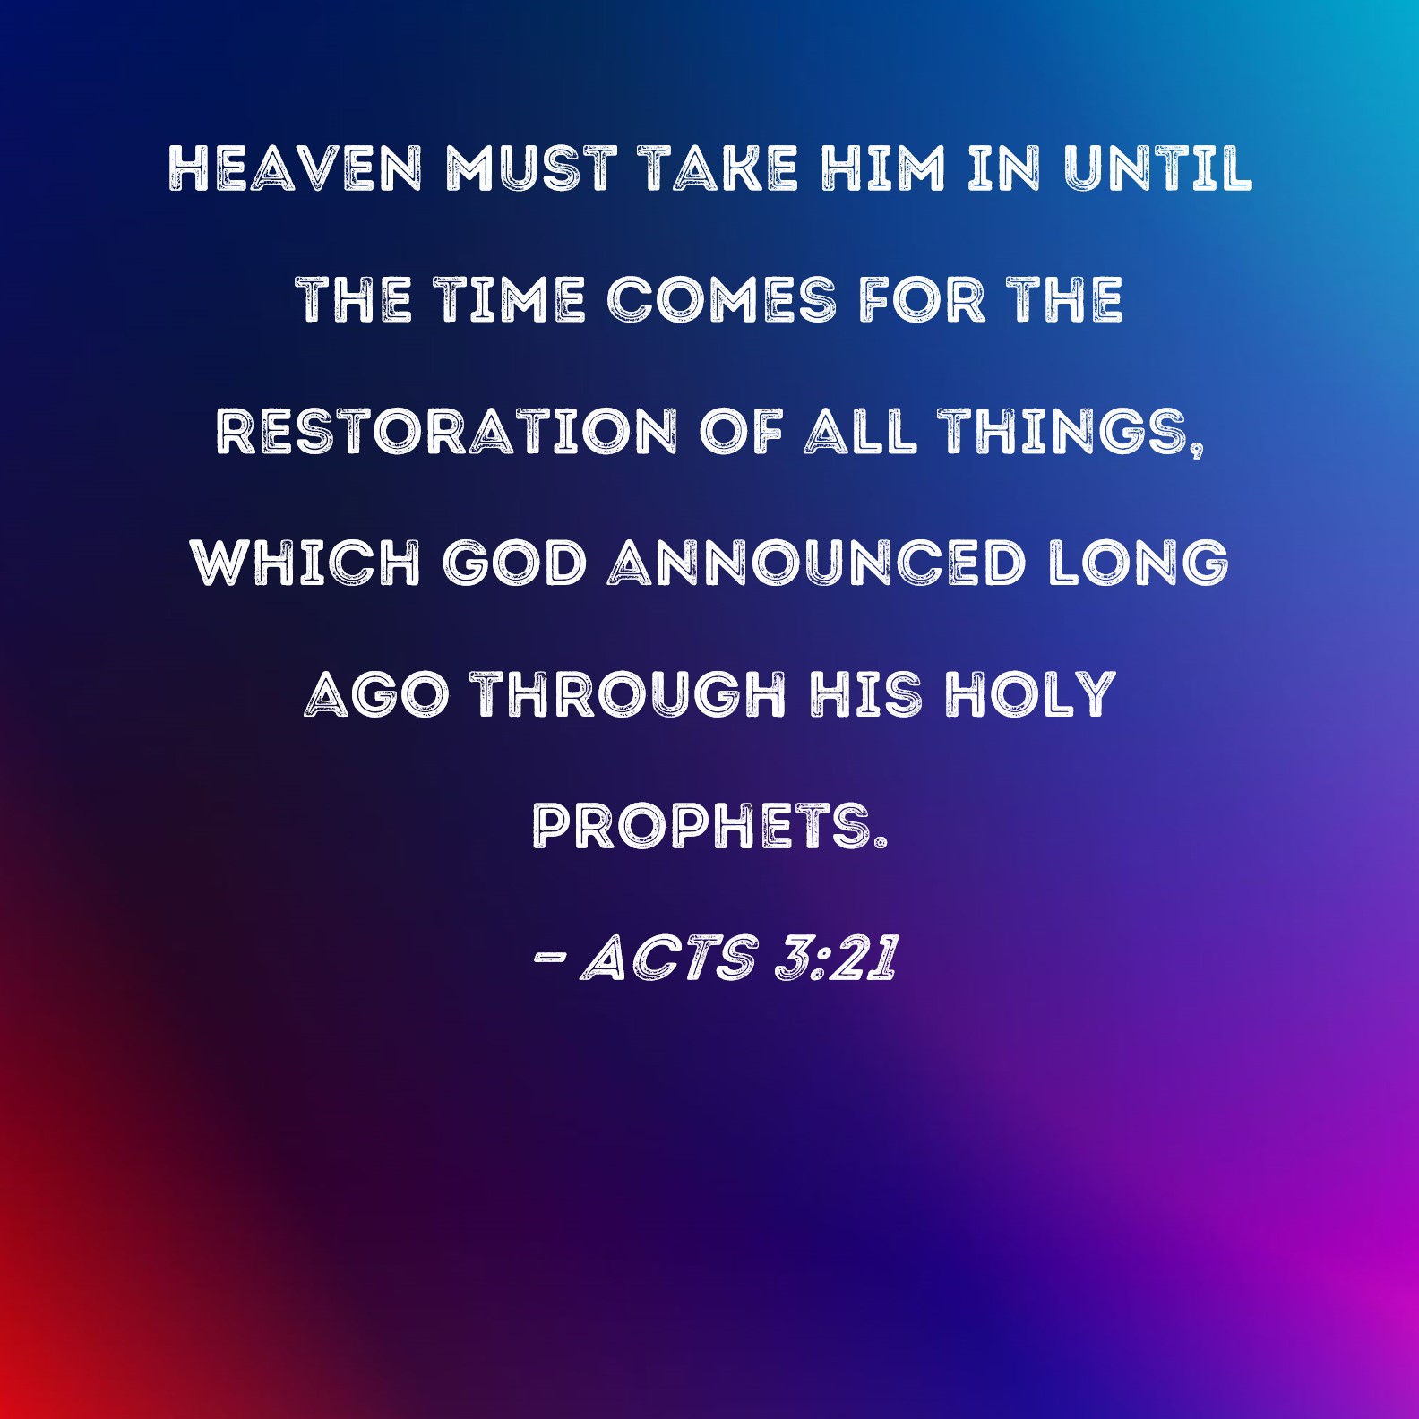

Slide 38
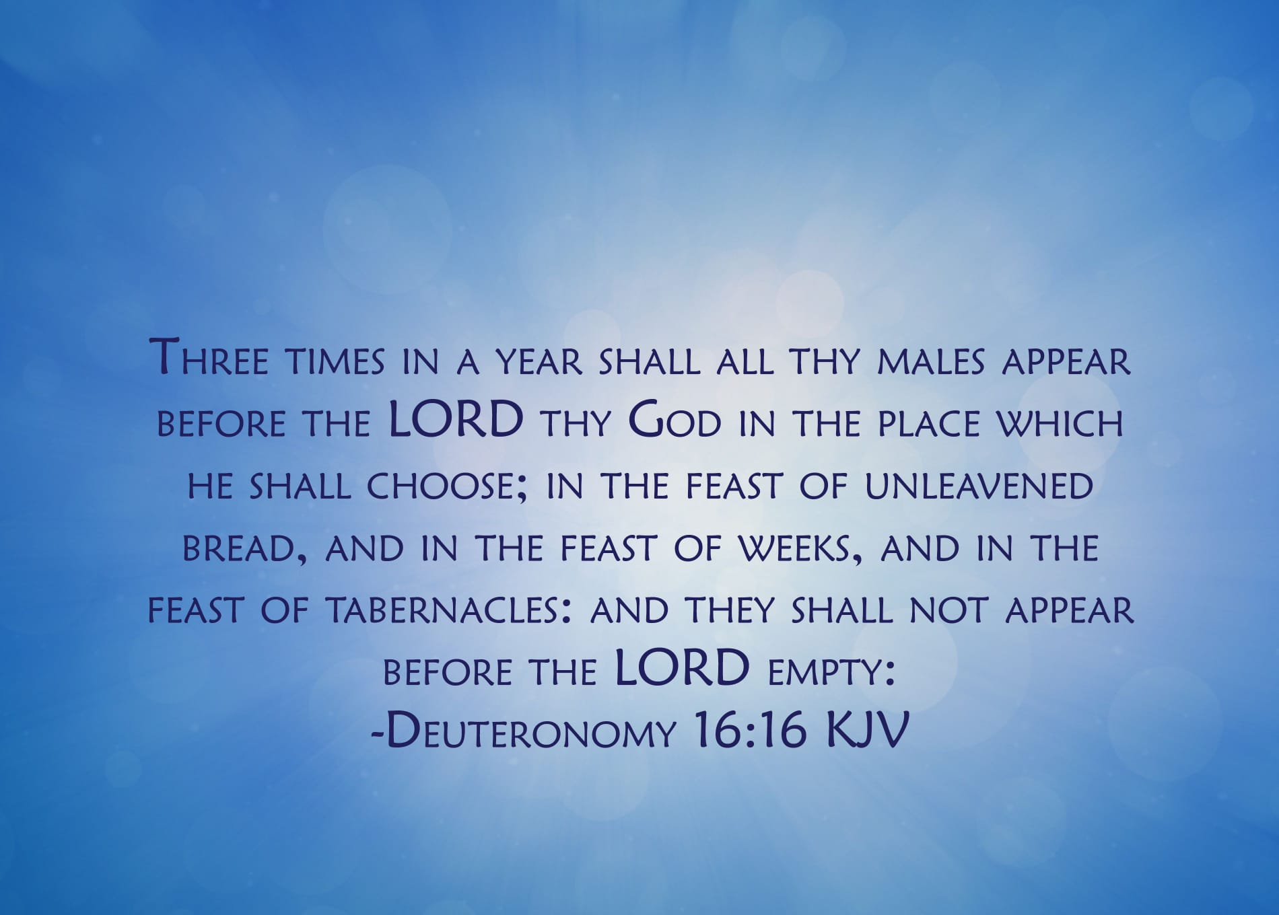
“Do not come empty handed…”

Slide 39
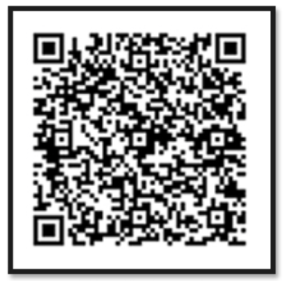

Slide 40
PASSOVER OFFERING

